Slide 1
Paging

Slide 2
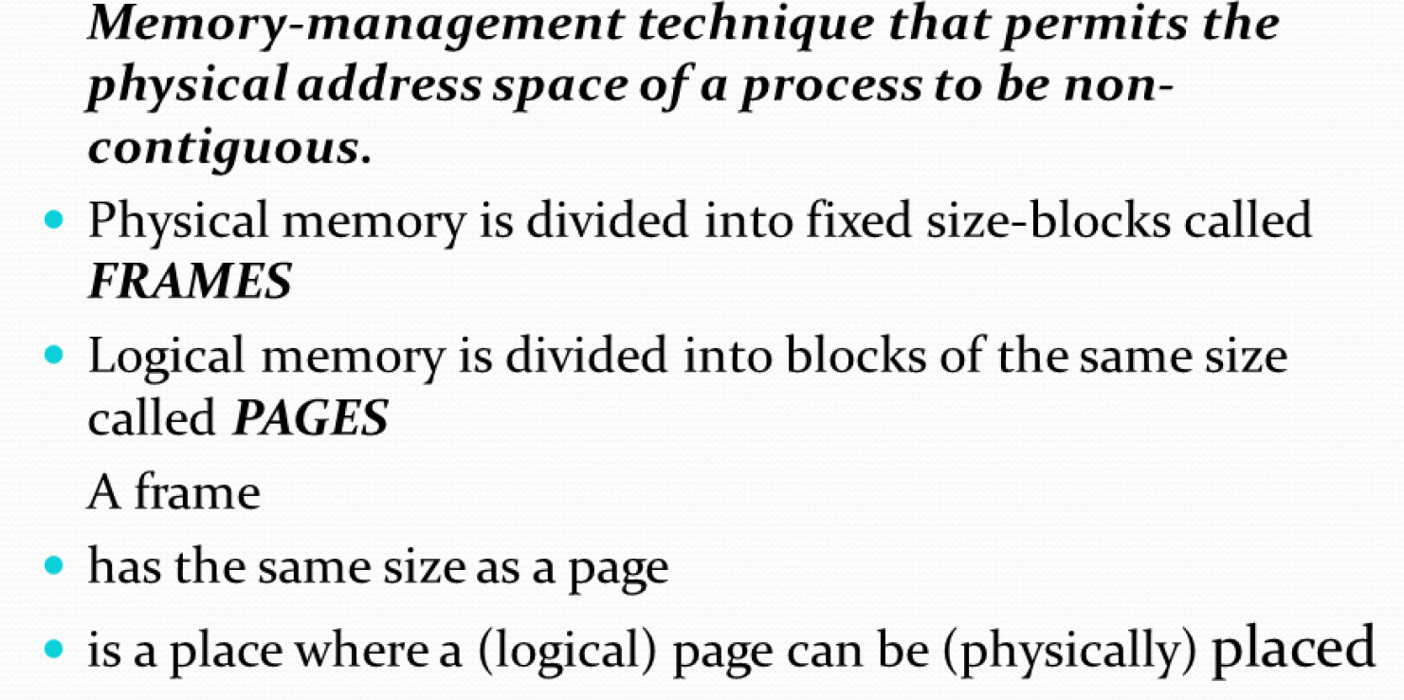

Slide 3
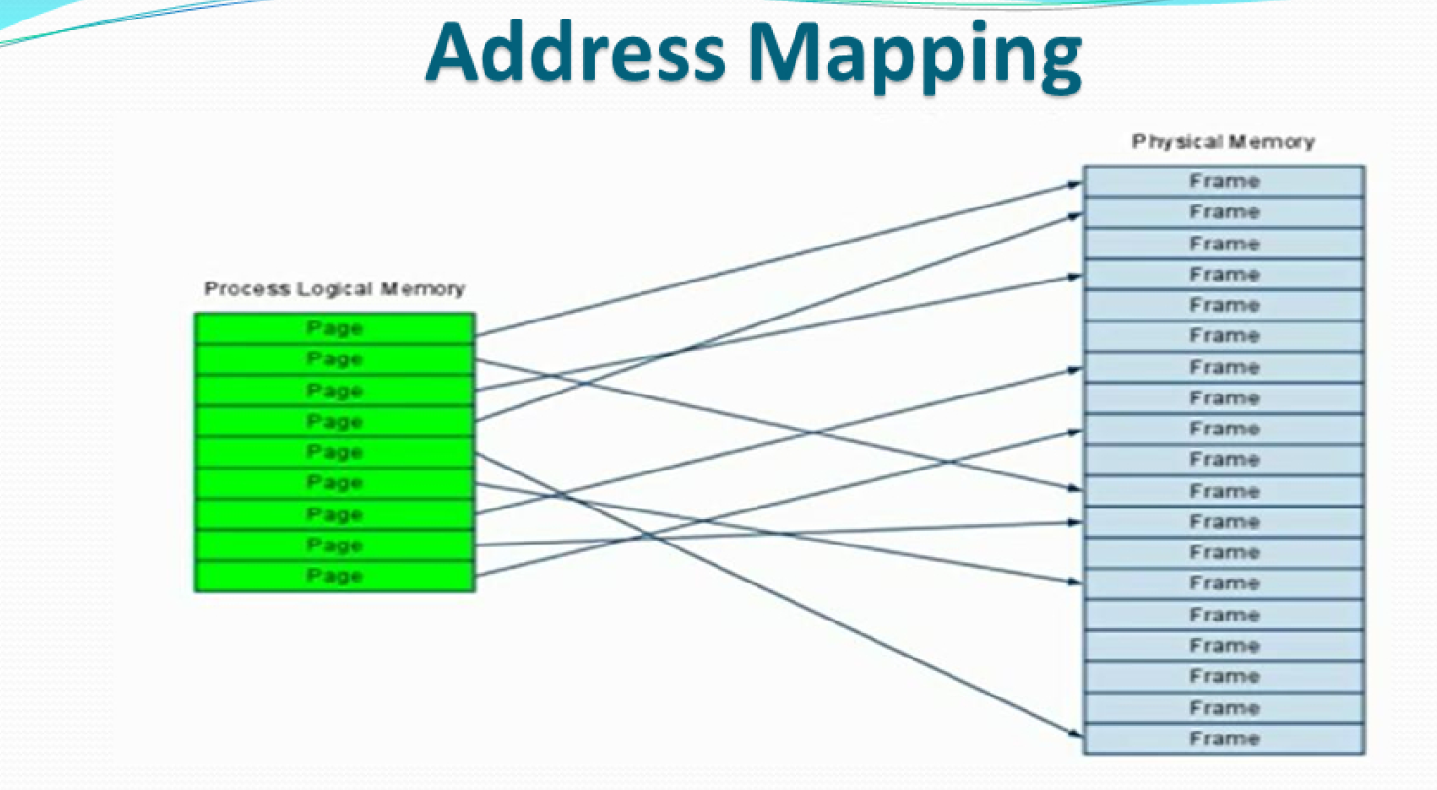

Slide 4
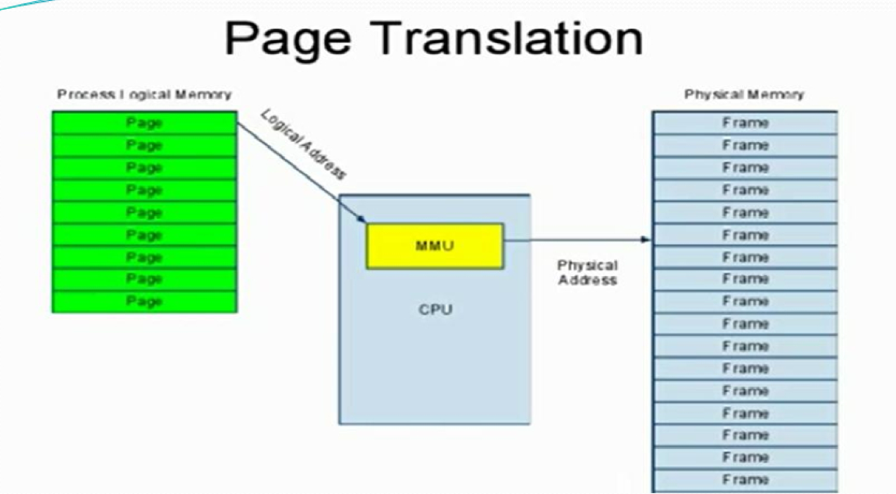

Slide 5
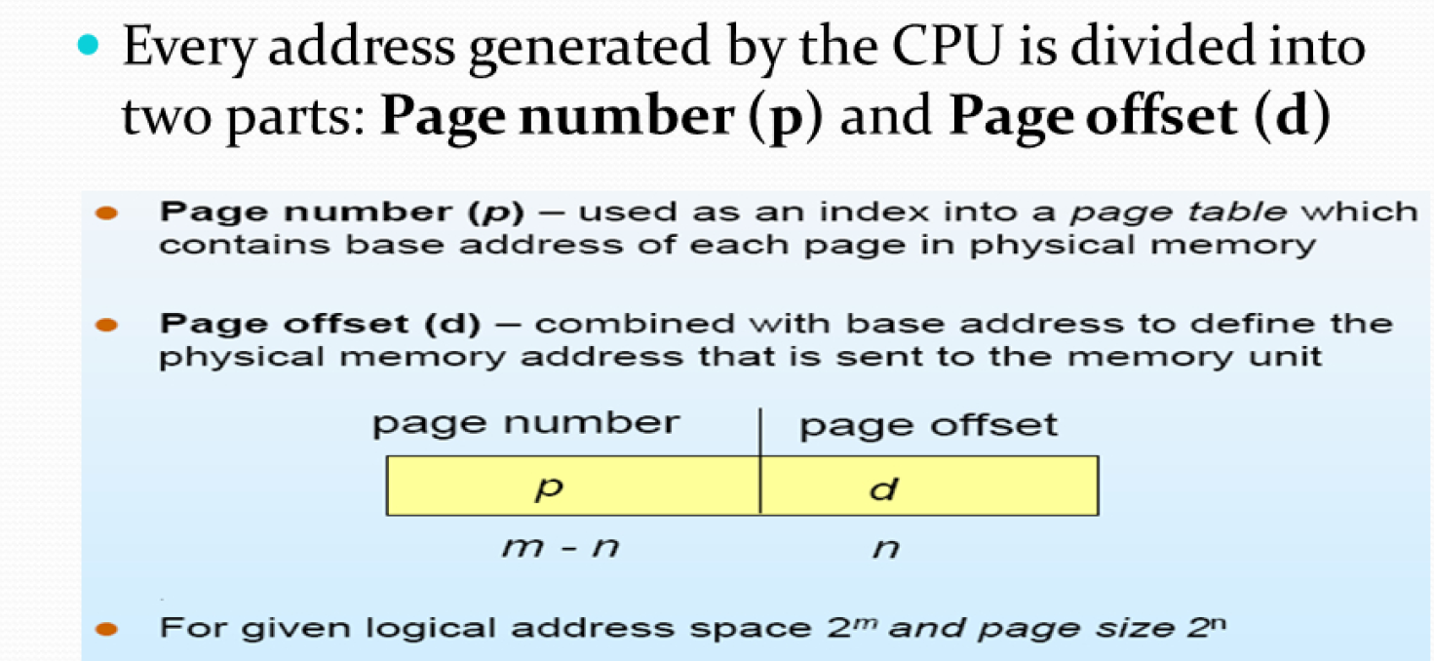

Slide 6
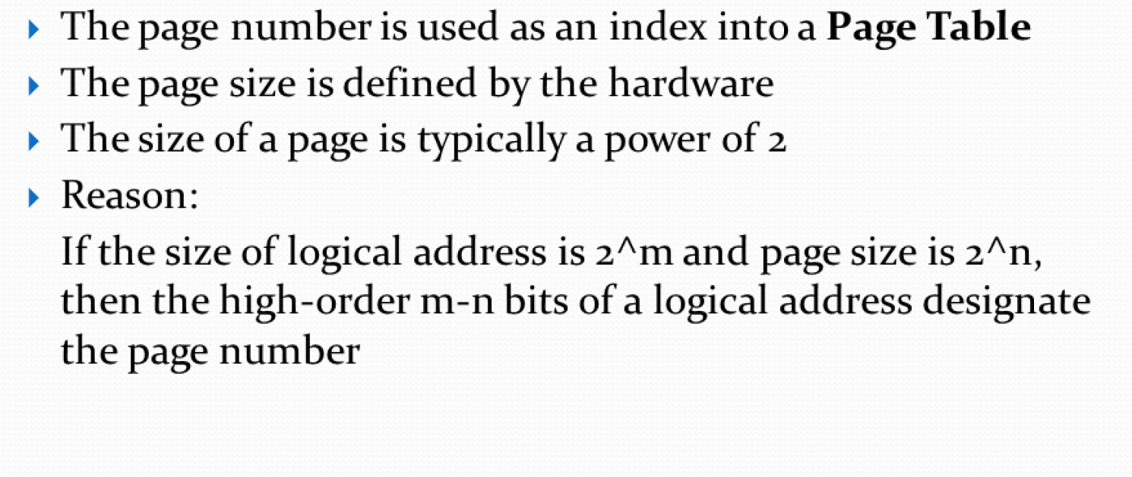

Slide 7
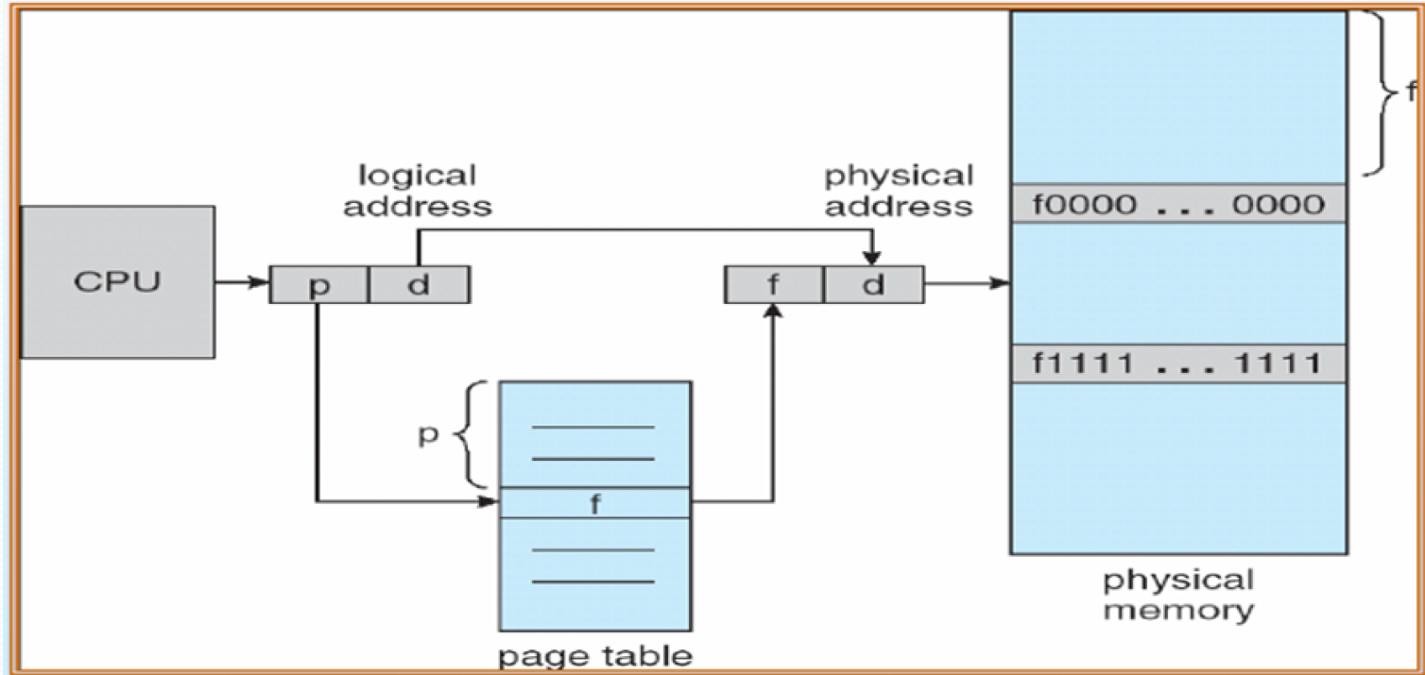

Slide 8
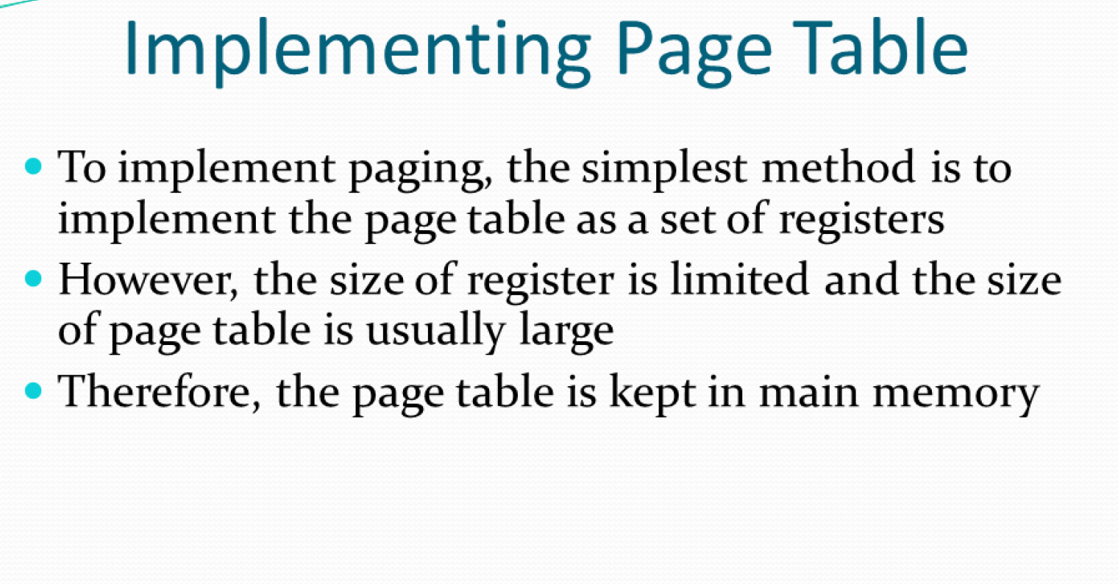

Slide 9
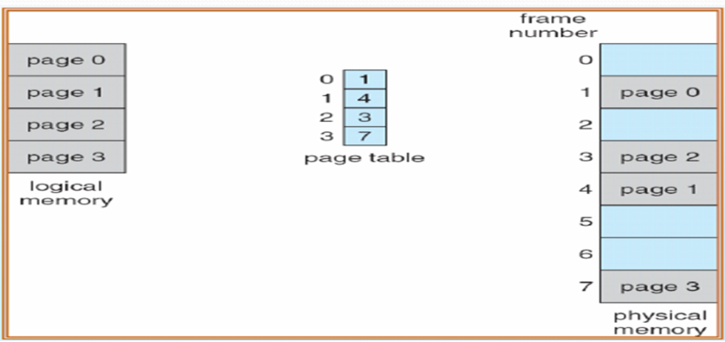

Slide 10
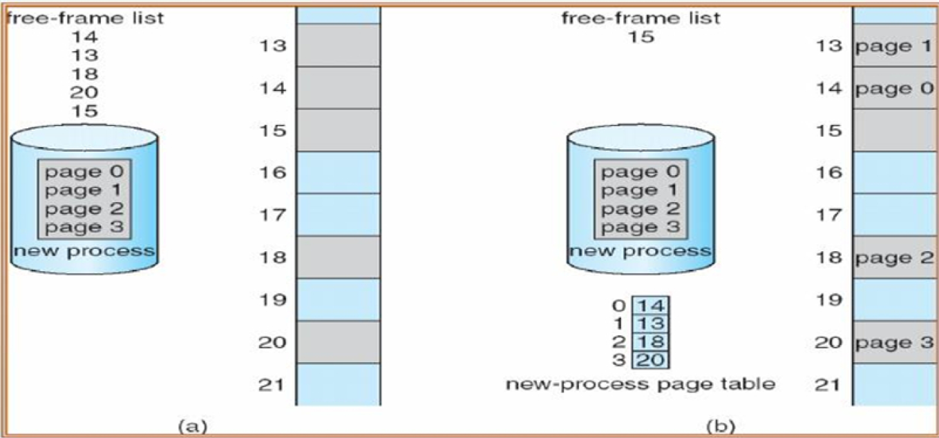

Slide 11
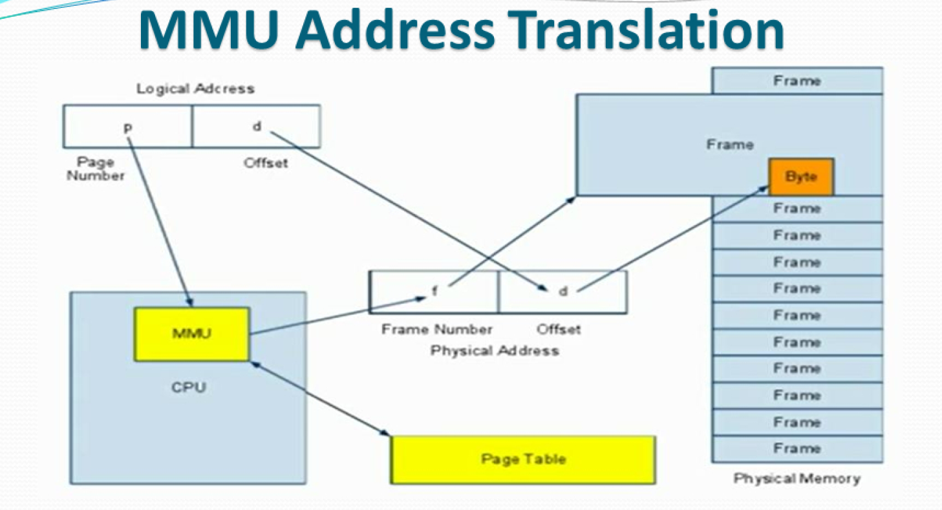

Slide 12
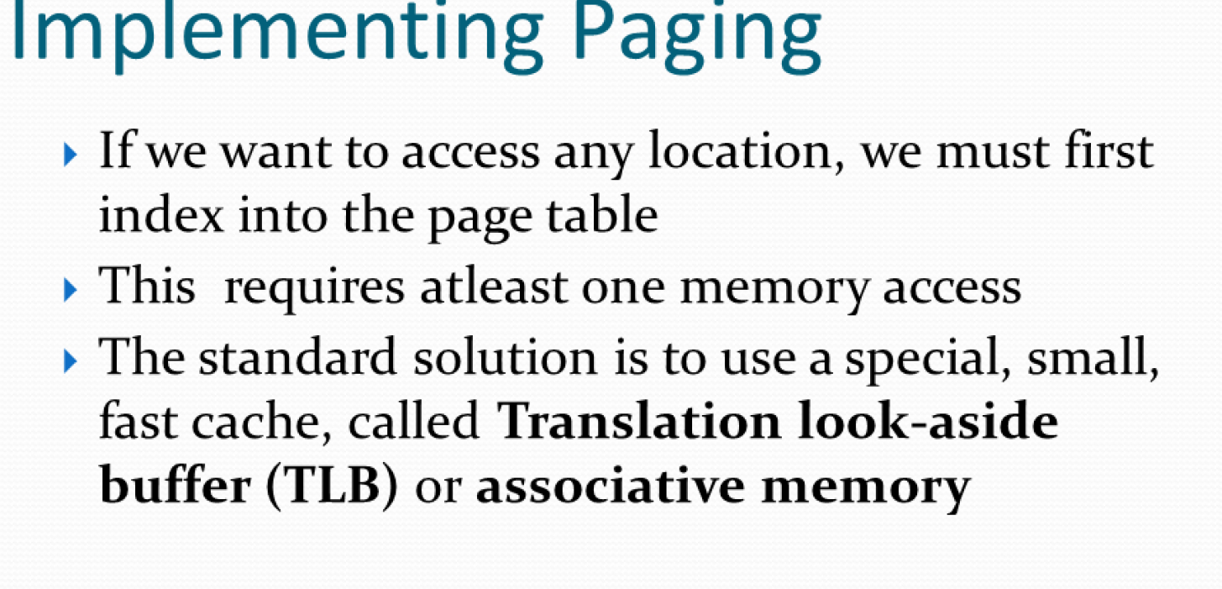

Slide 13
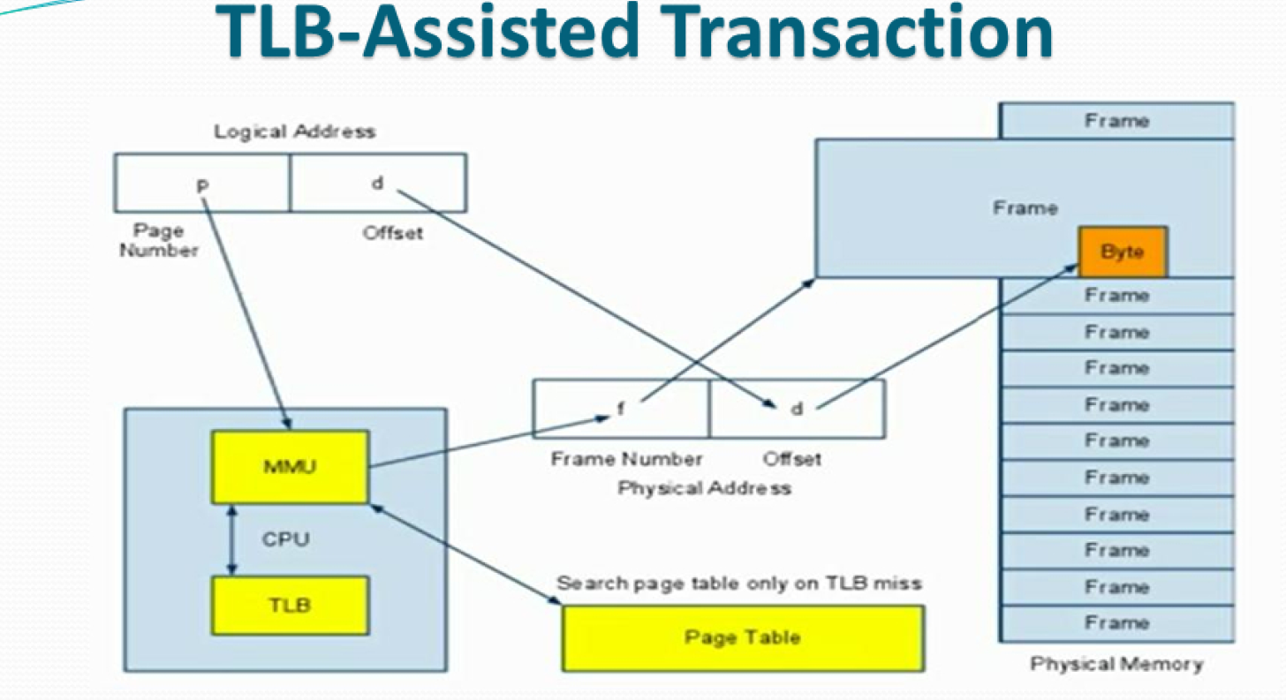

Slide 14
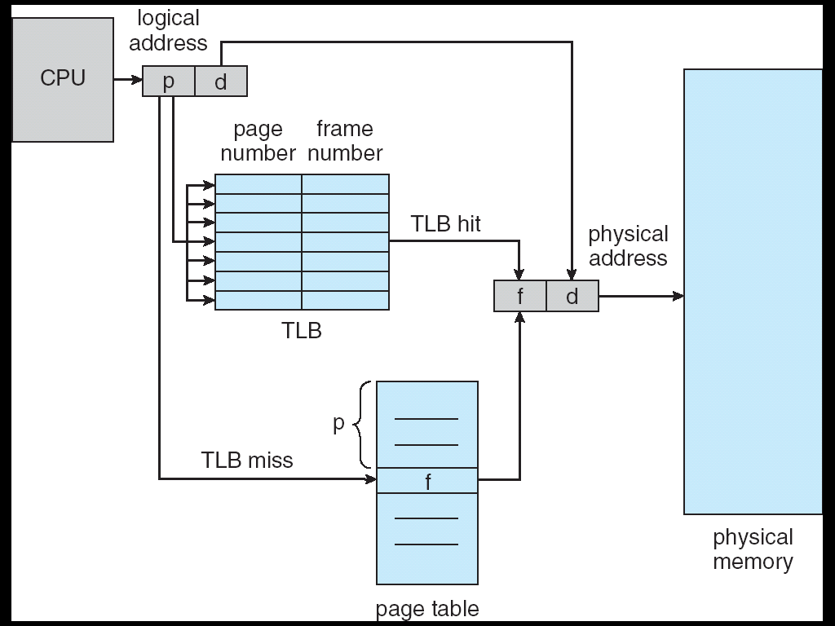
Paging Hardware With TLB
Notes:
hw 1 - Extract VPN from address (easy: just take the top bits from the address)
hw 2 - Use the VPN to index the TLB
hw If (the translation is in the cache) // a TLB hit
hw 3a - get PPN from TLB
hw 3b - use it to form physical address
hw 3c - issue request for physical address to the memory system
hw else (translation is NOT in the cache) // a TLB miss
hw/os 4a - lookup translation in the page table (in memory)
hw/os 4b - if it is *valid*
hw/os install the translation into the TLB
hw/os retry the instruction (which will hopefully now be a TLB hit)
hw 4c - if not valid, trap (invalid memory access)
os terminate process (clean up)

Slide 15
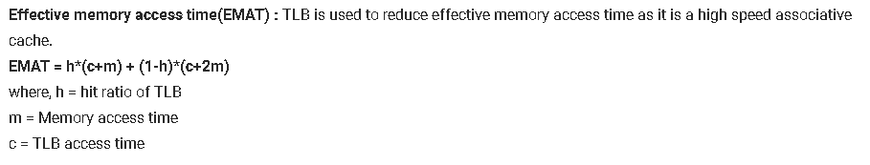

Slide 16
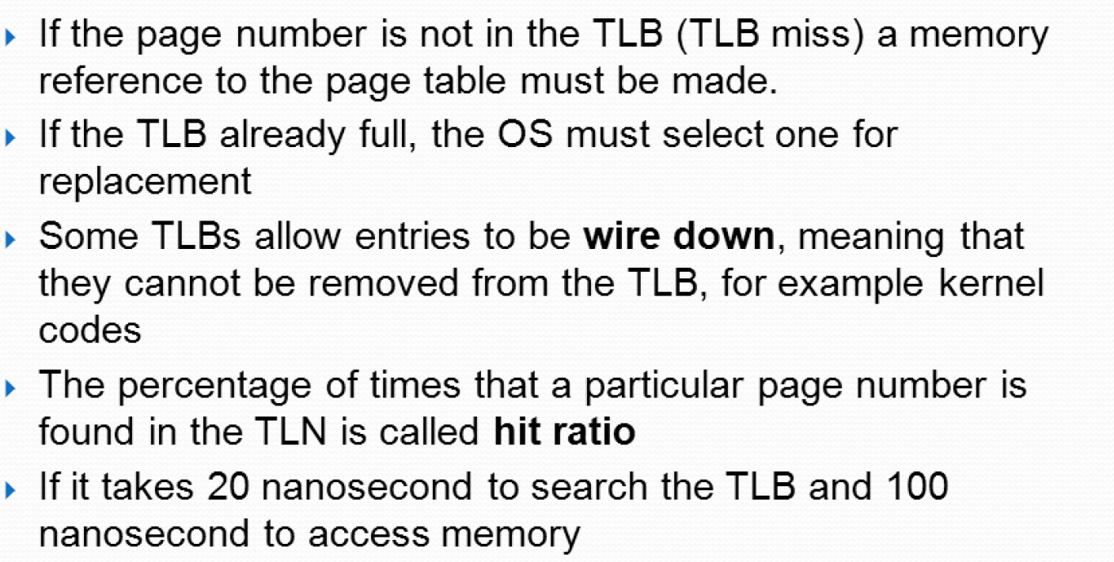

Slide 17
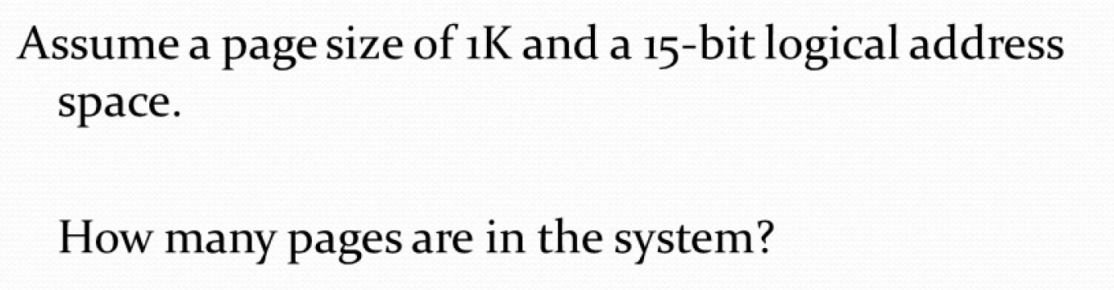

Slide 18
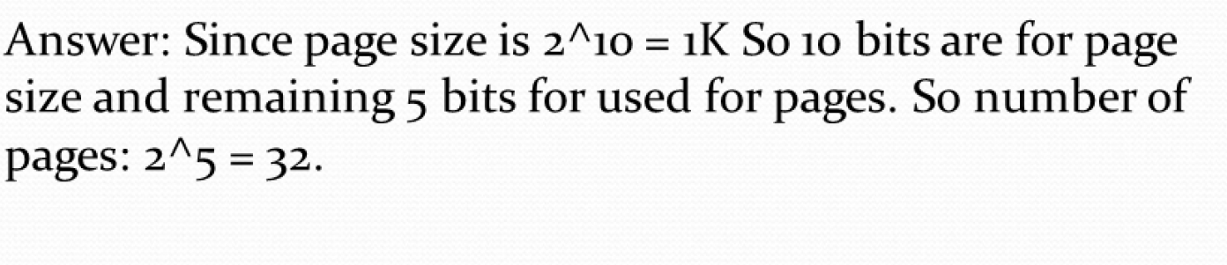

Slide 19
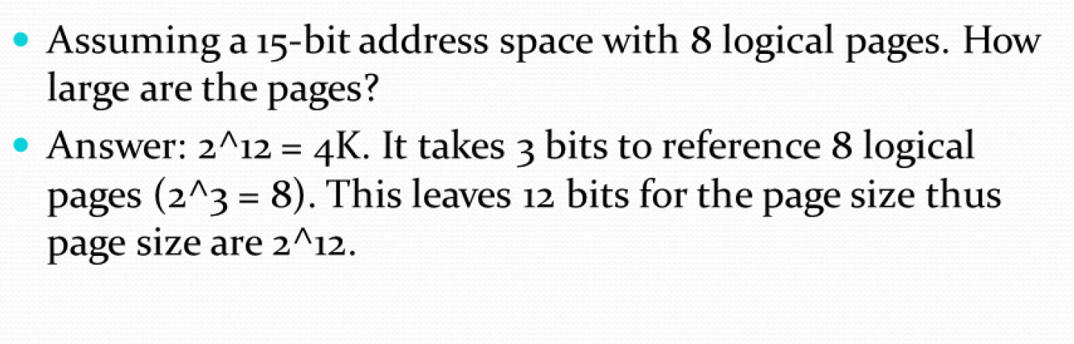

Slide 20
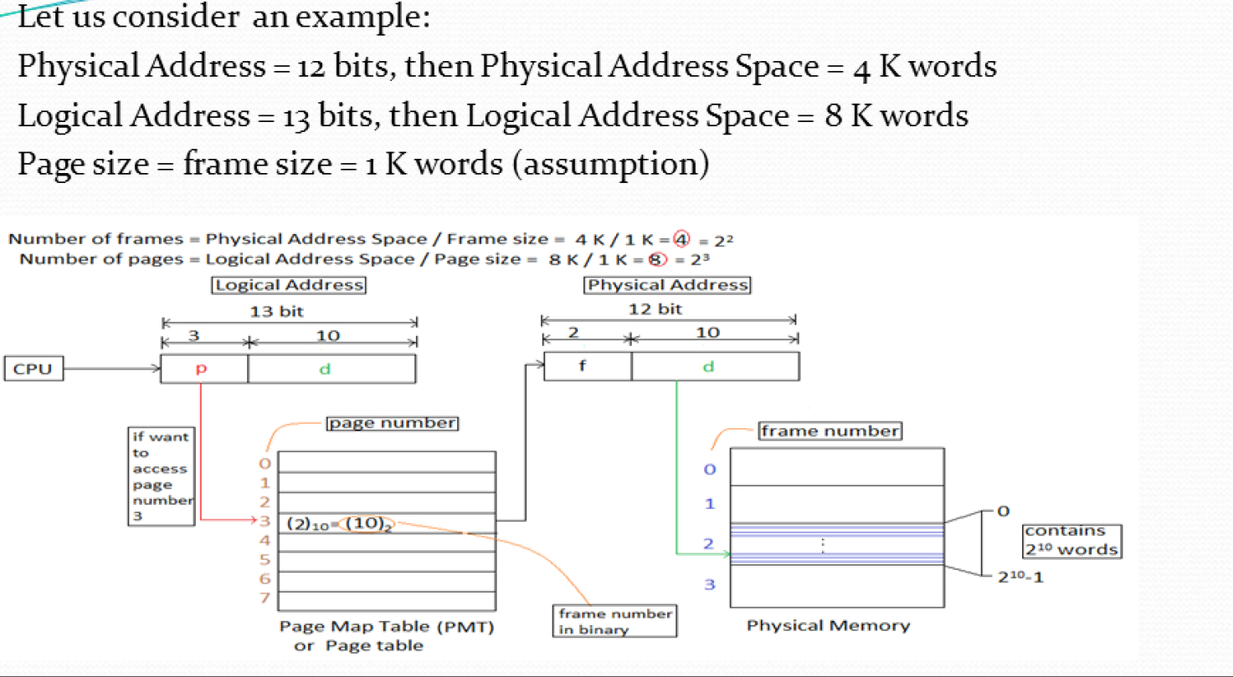

Slide 21
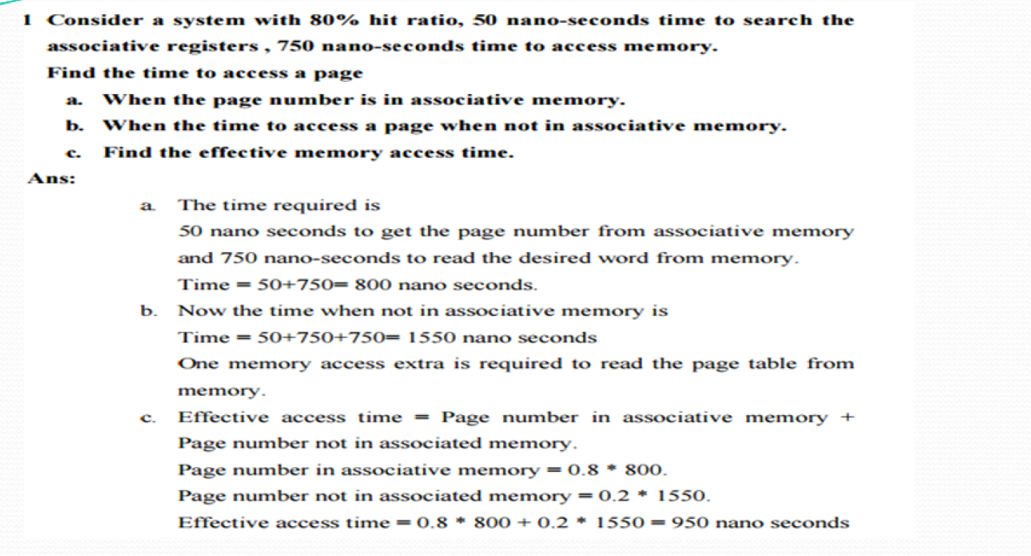

Slide 22
